Slide 1
Data Structure
Lab Session #1
Introduction
U Kang
Seoul National University

Slide 2
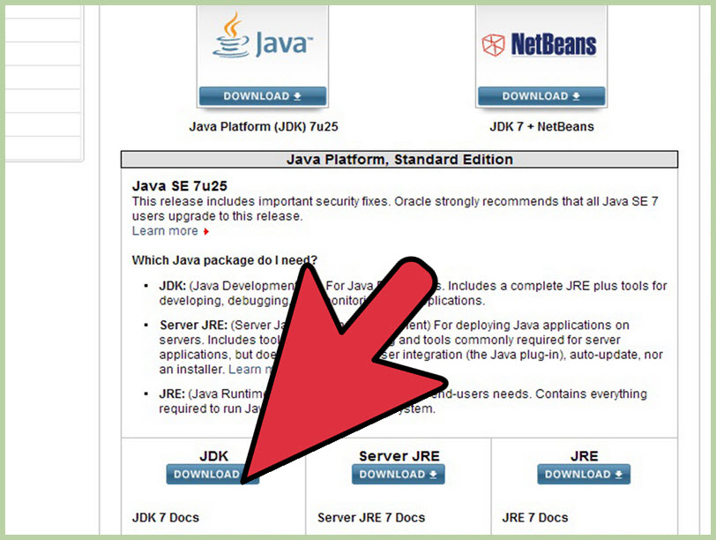
How to install JDK?
Visit the Java downloads page on Oracle's website(http://www.oracle.com/technetwork/java/javase/downloads/index.html) to find the JDK environment download.

Slide 3
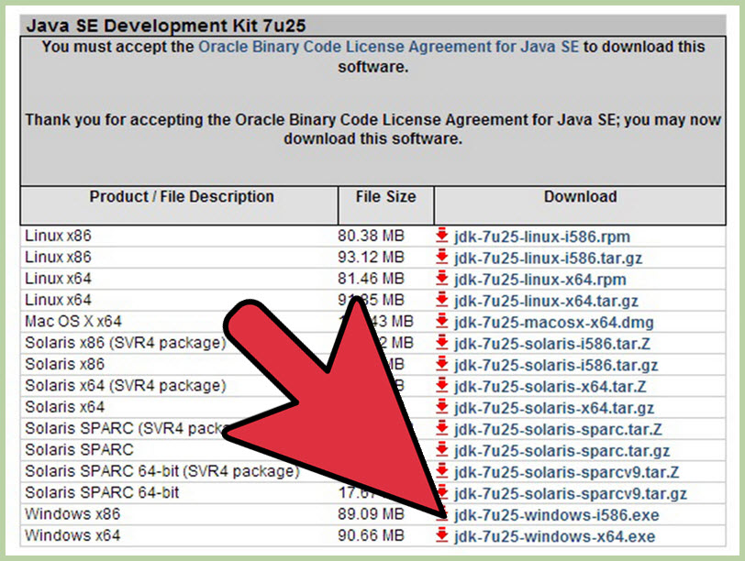
How to install JDK? (cont.)
Once you have selected download, accept the terms of service and choose the correct OS corresponding for the specific JDK. (Windows, Mac, Linux, etc.)

Slide 4
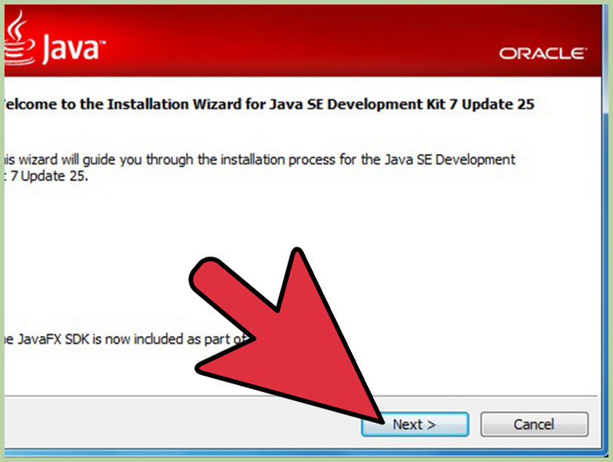
How to install JDK? (cont.)
Once the download is complete, double click the file to begin the installation of JDK.

Slide 5
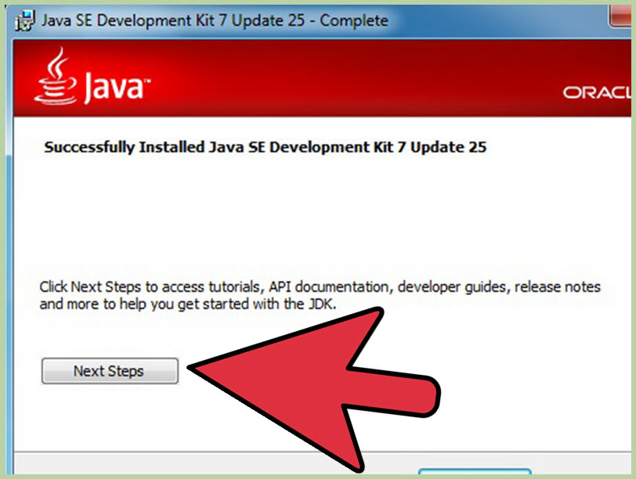
How to install JDK? (cont.)
After the initial installation is done, a pop up asking you where your source java files will be. You can choose to change where you want to keep your folder but it’s best to stick with what you were given first.

Slide 6
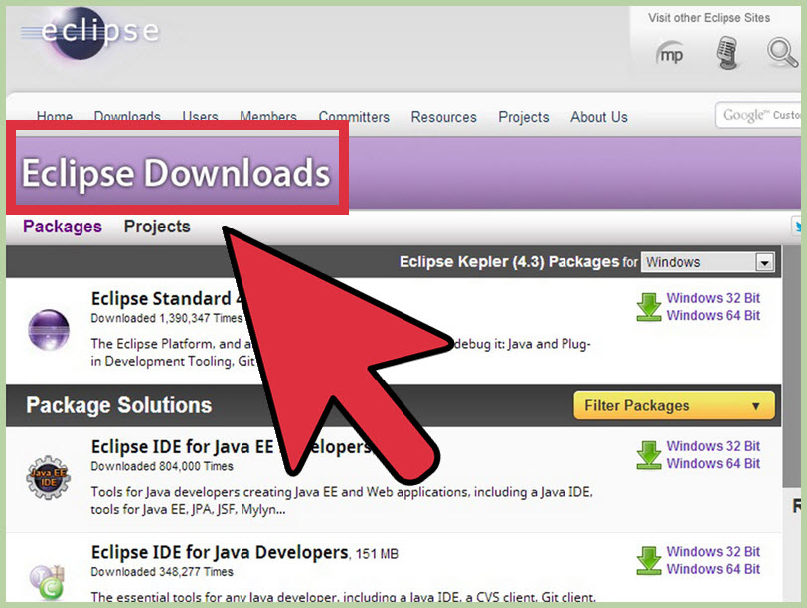
How to install Eclipse?
When the installation is finished, we will begin to the installation of Eclipse. Go to http://www.eclipse.org/downloads/.

Slide 7
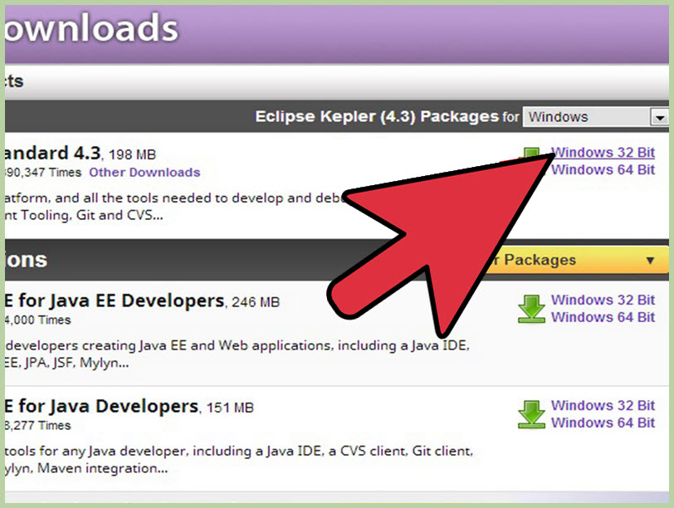
How to install Eclipse? (cont.)
For Windows users, you will have to know what type of version of your OS you have. If your computer is a 64 bit Windows , select Windows 64 and if you have a 32 bit Windows, select Windows 32 bit.

Slide 8
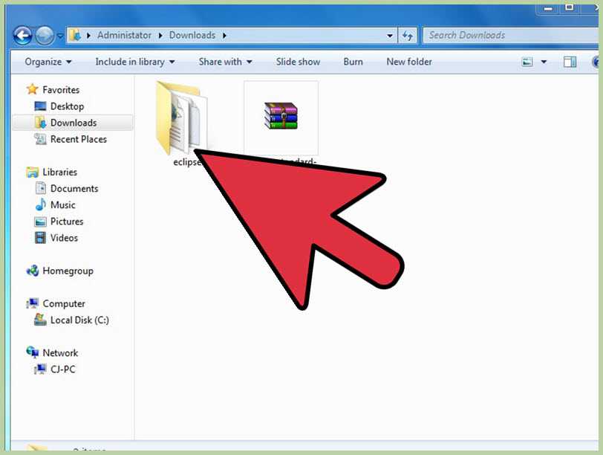
How to install Eclipse? (cont.)
Once you have downloaded the Eclipse archive you will need to decompress the zip file, which will create the unzipped Eclipse folder.

Slide 9
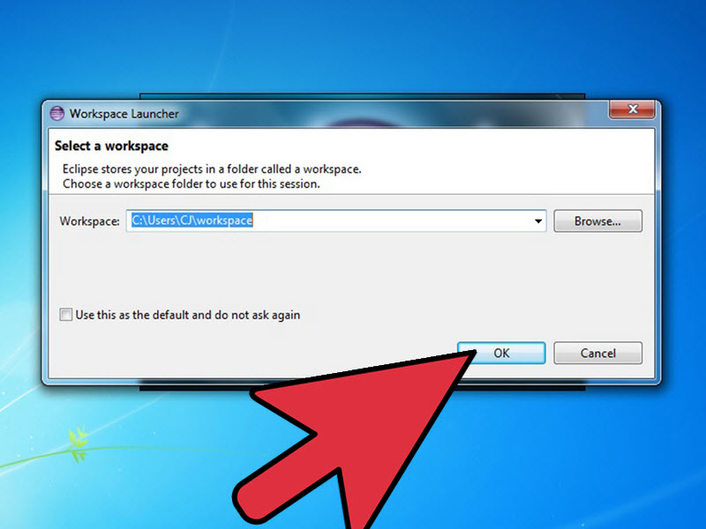
How to install Eclipse? (cont.)
After eclipse has been fully installed and extracted, create a workspace folder where you will contain all the program files you create.

Slide 10
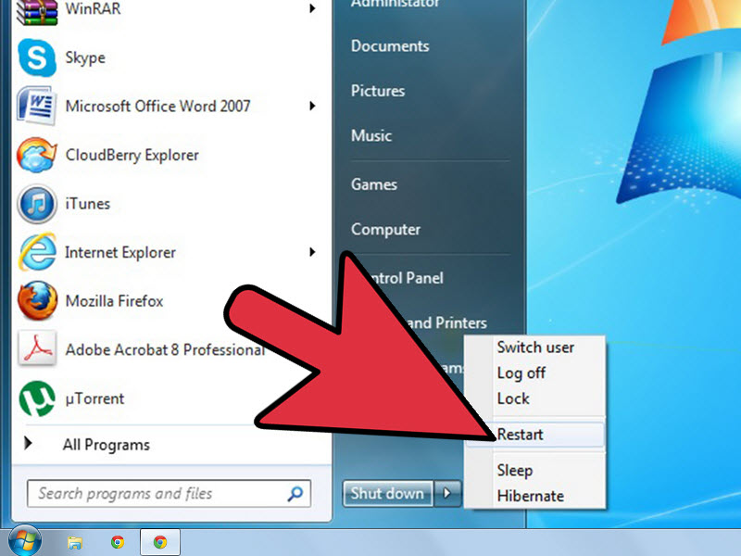
How to install Eclipse? (cont.)
Now that you have finished installing Eclipse, restart your computer. Restarting your computer refreshes system memory and allows registration or configuration changes made by installers and uninstallers to take effect.

Slide 11
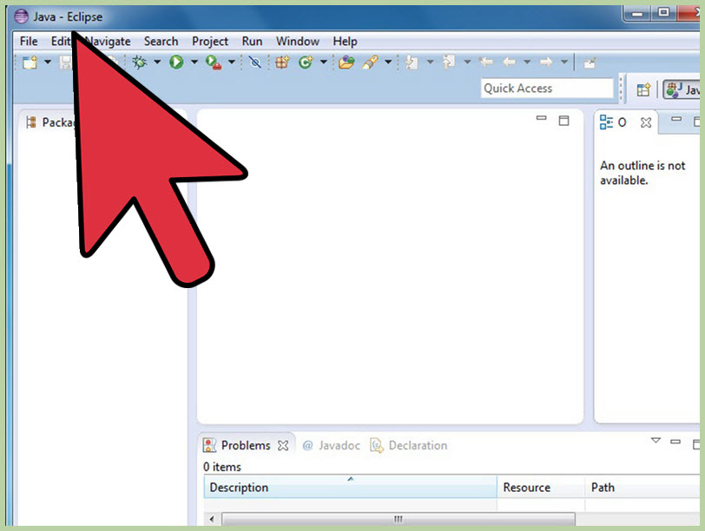
How to install Eclipse? (cont.)
From there, create a test program to test the functionality of Eclipse.

Slide 12
Open a project in Eclipse (1)
Download a project:
http://etl.snu.ac.kr/pluginfile.php/1454640/mod_ubboard/attachment/835402/PA_00.zip?forcedownload=1
Extract the downloaded file.
In Eclipse, open the project
[File]-[Import]
Select “Existing Projects into Workspace”
“Select root directory” – [Browse]
Pick the extracted folder

Slide 13
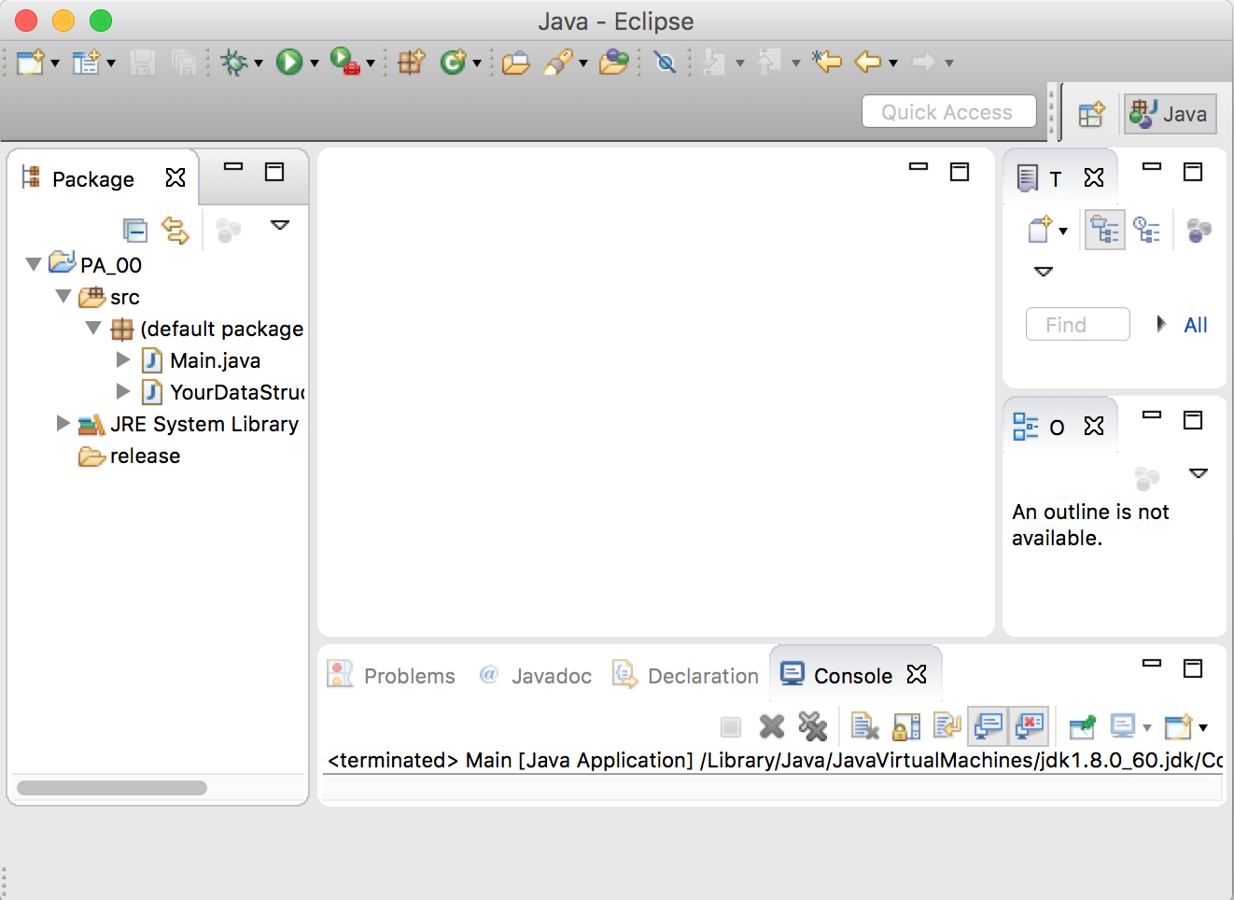
Open a project in Eclipse (2)

Slide 14
Run the project
Just Click “Run” button (or Ctrl-F11)
Enter a number and check if the console says the same number.
To terminate, push Ctrl-D.

Slide 15
Create JAR file
[File]-[Export]
Select [Java]-[JAR file]
JAR file destination:
PA_00/release/PA_00_2015-12345.jar

Slide 16
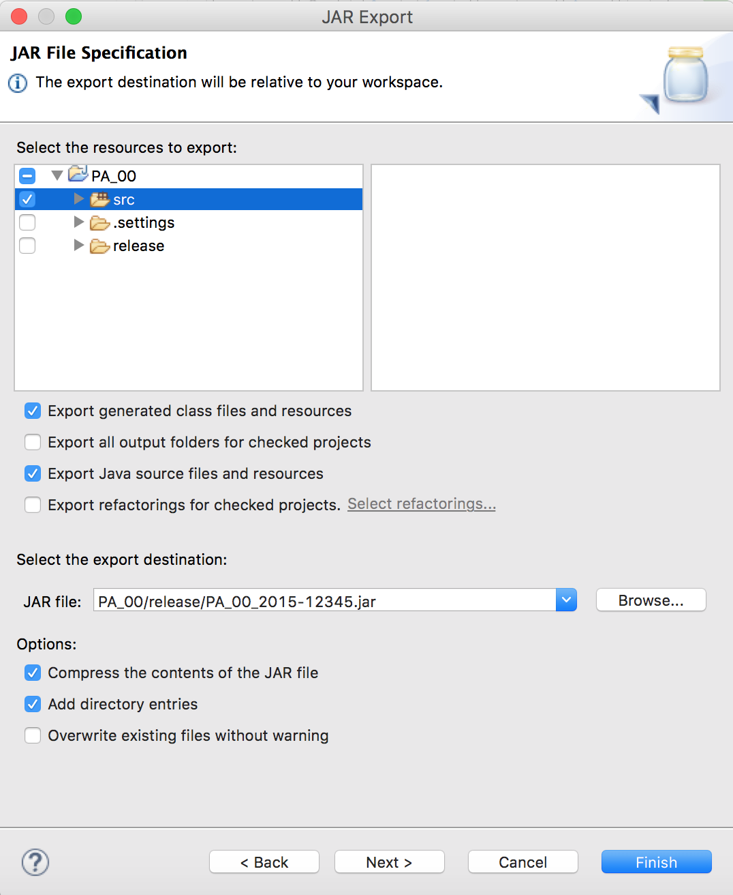
Create JAR file (2)
Checkboxes
Must check “src” folder
MUST uncheck “release” folder
MUST check “Export generated class files and resources”
MUST check “Export Java source files and resources”

Slide 17
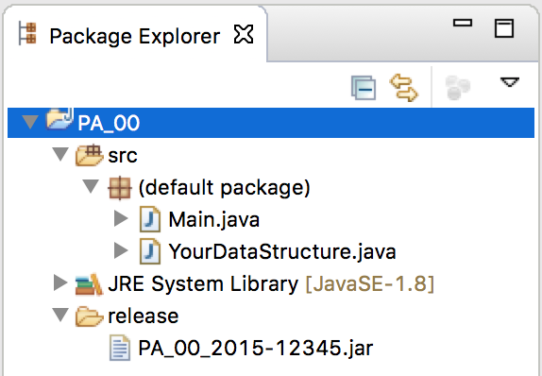
Check your JAR file

Slide 18
Check your JAR file (2)
Go into the directory which contains the JAR file in your terminal (such as cmd)
Type:
java –classpath ./ PA_00_2015-12345.jar Main

Slide 19
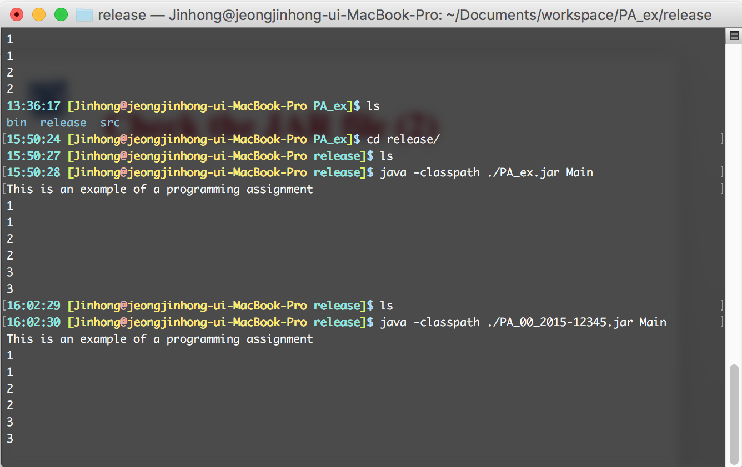
Check your JAR file (2)

Slide 20
Course Introduction
TA
Jinhong Jung
Email: montecast9@gmail.com
Office Hour: Thursday 13:00 – 14:00
Office: 301 - 519
Minsoo Jung
Email: qtyp456987@gmail.com
Office Hour: Friday 13:00 – 14:00
Office: 301 - 519

Slide 21
Reference
http://www.wikihow.com/Download,-Install,-and-Run-JDK-and-Eclipse
http://www.oracle.com/technetwork/java/index.html
http://www.eclipse.org/

